Slide 1
05 | More on Parameters
Jeffrey Snover | Distinguished Engineer & Lead Architect
Jason Helmick | Senior Technologist, Concentrated Technology

Slide 2
Module Overview
Mandatory parameters
Switch parameters
Accepting pipeline input
Parameter help
Parameter aliases
Parameter validation

Slide 3
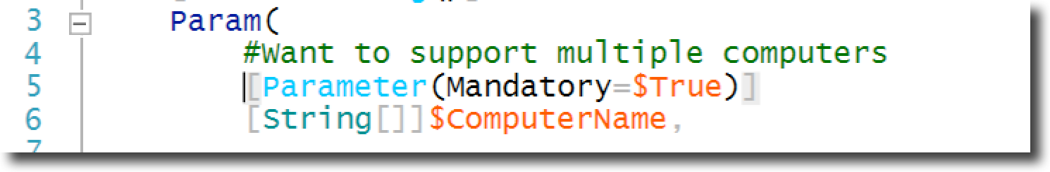
Mandatory Parameters
Get-Help About_Functions_Advanced_Parameters

Slide 4
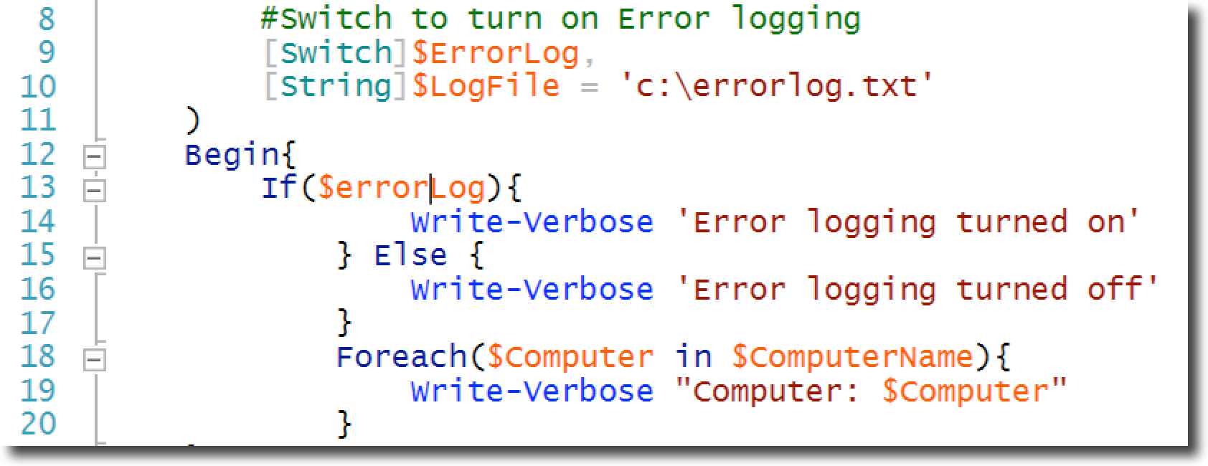
Switch Parameter
Get-Help About_Functions_Advanced_Parameters

Slide 5
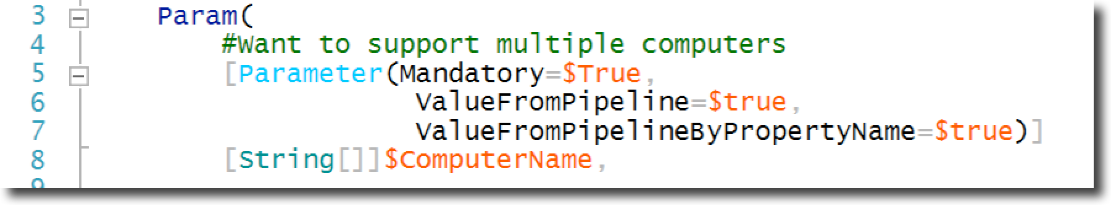
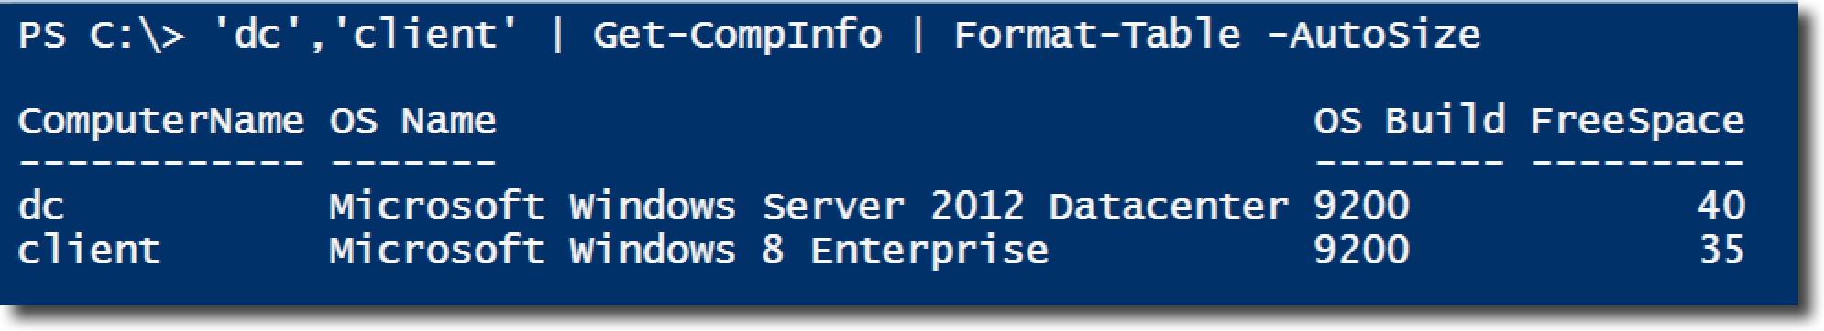
Accepting pipeline input

Slide 6
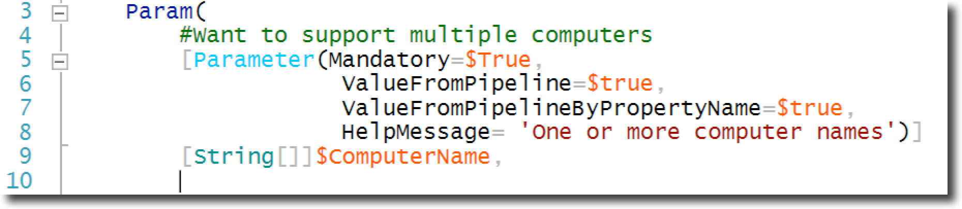
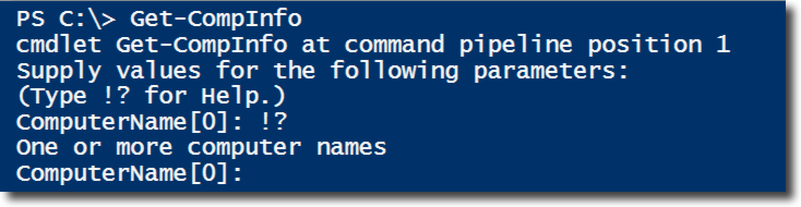
Parameter help

Slide 7
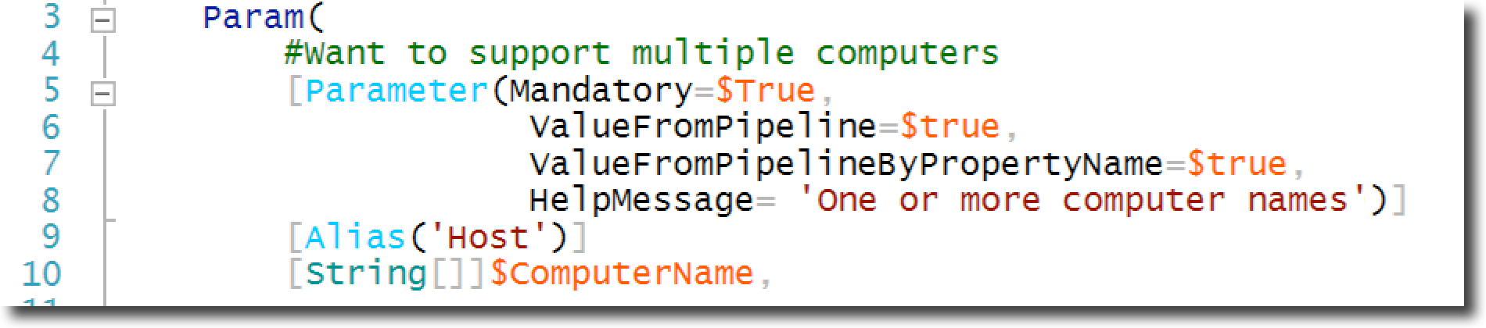
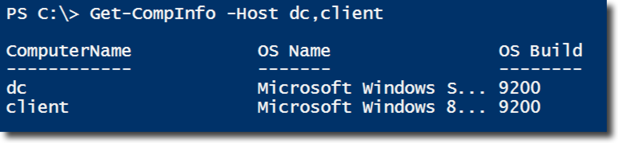
Parameter Alias

Slide 8
Parameter Validation

Slide 9
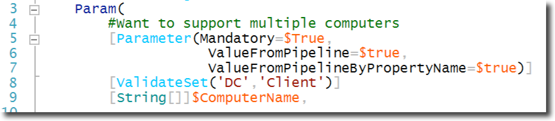
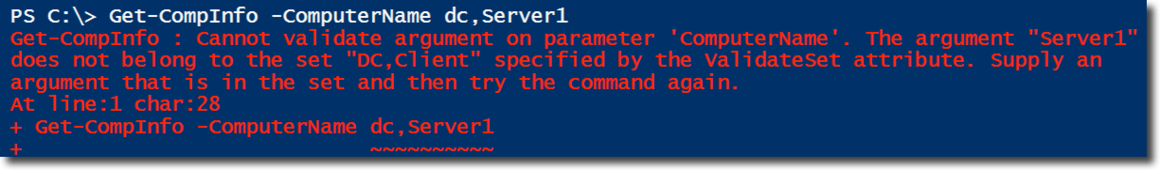
Parameter Validation - ValidateSet
Get-Help About_Functions_Advanced_Parameters
ValidateSet

Slide 10
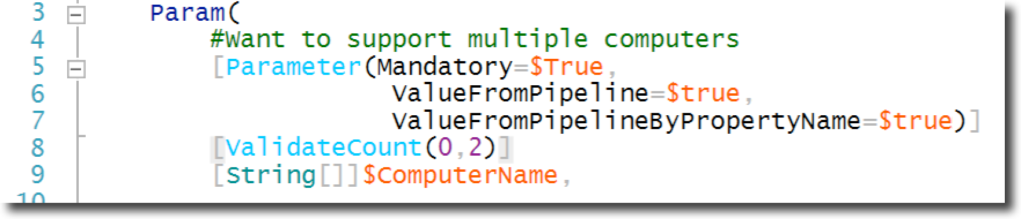
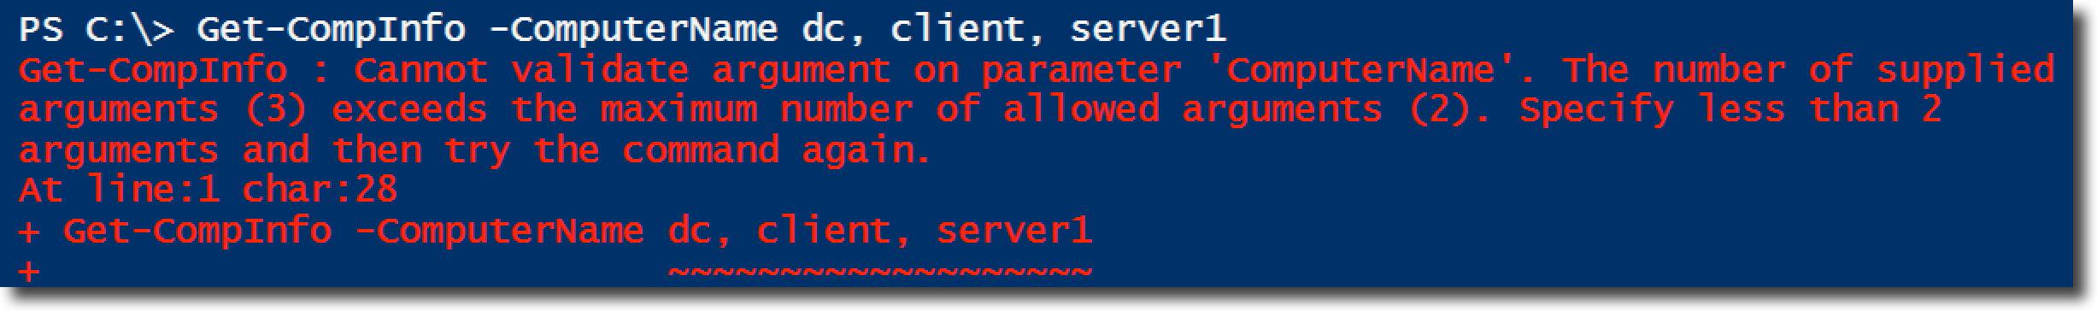
Parameter Validation - ValidateCount
Get-Help About_Functions_Advanced_Parameters
ValidateCount

Slide 11
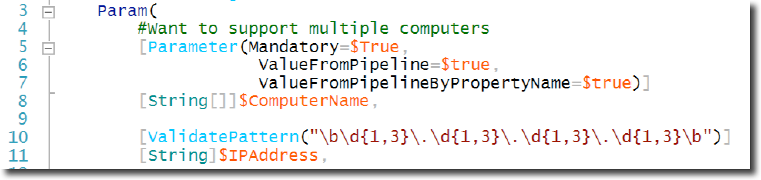
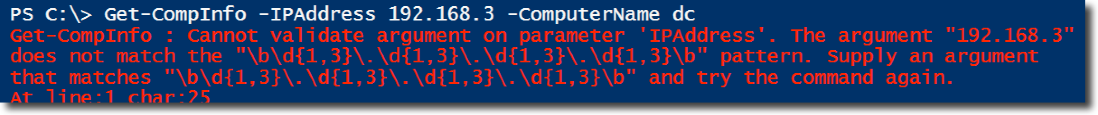
Parameter Validation - ValidatePattern
Get-Help About_Functions_Advanced_Parameters
ValidatePattern

Slide 12
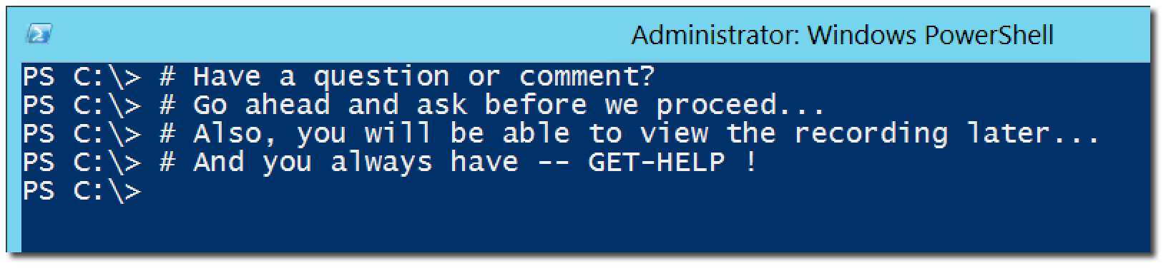
Questions or comments?

